Slide 1
Math Enrichment: Carleton experience

Slide 2
Carleton Math Enrichment Centre
First class held in 2006,
attendance: 1 high school teacher
Academic year 2016/17:
12 weekly courses and programs
500 students
Math Enrichment Centre is supported in part
with an Endowment Grant from the Canadian Mathematical Society

Slide 3
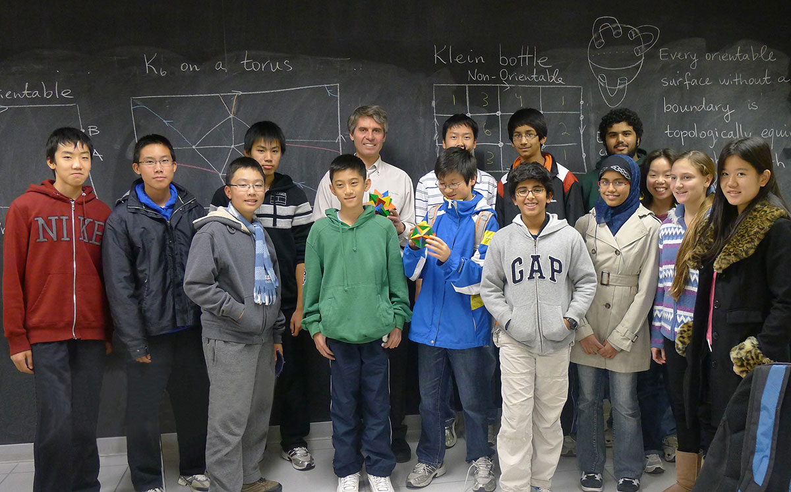
… one of our classes

Slide 4
Our courses and programs:
Math Kangaroo Adventures (3-4, 5-6)
Introduction to Algebra (7-8)
Fundamentals of Geometry I (7-8)
and II (8-9)
Competitve Math I (9) and II (9-12)
MATHEMA I (9)
and II (10)
MathLink (9-10)
Foundations of Calculus (10-12)
Algebra and Trigonometry (11-12)
JAVA Programming (10-12)
Math Connections in Arts and Science (8-10)

Slide 5
Math Kangaroo Adventures (3-4, 5-6)
Offered in partnership with the Canadian Math Kangaroo Contest
3 classes at each level 3-4 and 5-6, with two undergraduate instructors per class
Topics covered: Numbers, Patterns, Geometry,
Math games and puzzles

Slide 6
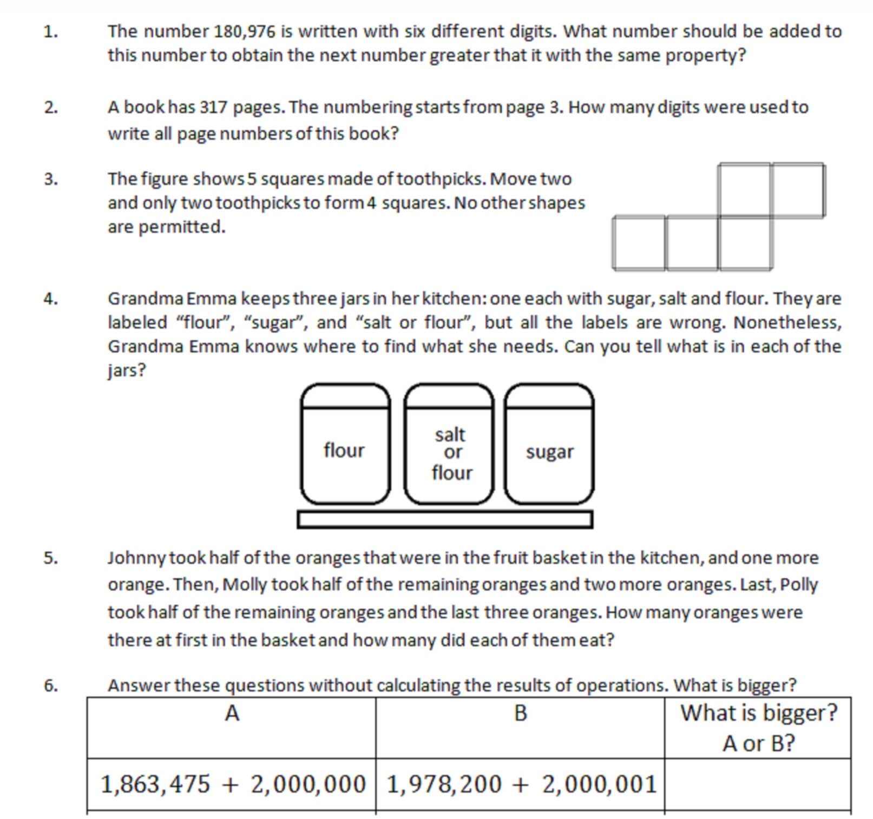

Slide 7
Introduction to Algebra (7-8)
Basic Algebra
Equations
Inequalities
Systems of equations

Slide 8
Foundations of Geometry I and II (7-8, 8-9)
Euclidean Geometry
Parallel lines, Isosceles tringle, Parallelograms,
Circle
Logic and Reasoning
Constructions with Ruler and Compass
Introduction to Trigonometry
Metric relations
3D Geometry

Slide 9
Competitive Math I and II (9-12)
Training for Math Contests

Slide 10
MATHEMA I and II (9, 10)
Runs on Saturdays with 3-hour classes
Three components:
Algebra
Physics
Computer Science

Slide 11
MathLink (9-10)
Patterns
Induction
Newton’s binomial
formula
Probability
Calculus
Error-correcting codes
Graph theory
Surfaces, maps on surfaces
Regular polyhedra
Vector geometry

Slide 12
Foundations of Calculus (10-12)
Algebra and Trigonometry (11-12)
JAVA Programming at a Glance (10-12)
Math Connections is Arts and Science (8-10)

Slide 13
Registration for September 2017
is now open!
http://carleton.ca/math/math-enrichment-centre/

